Slide 1
Subject: Multimedia CHAPTER-5: Data Compression
By: Er. Ramesh Basaula

Slide 2
Contents
5. Data compression
5.1 Data compression and coding fundamentals
5.2 Basic data compression, techniques, data compression
5.3 Coding standard JPEG MPEG and DVI

Slide 3
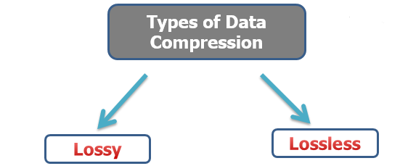
5.1 Data Compression
It denotes compact representation of data.
Some types of data where we can apply compression are: text, speech, image and videos, etc.
It is the process of encoding information using fewer bits than the original representation.
Types of data compression:

Slide 4
Lossless Data Compression
As per it’s name, no data loss.
Recovery of original data.
This method makes use of data compression algorithms that allows the exact original data to be reconstructed from the compressed data.
Text, other documents are compressed using this method.
Example: Run-length encoding, Huff-man coding, Arithmetic coding, etc.
2. Lossy Data Compression
As per it’s name, data is lost during compression.
No recovery of original data.
It is one where compressing data and its decompression retrieves data that may will be different from the original, but is “close enough” to be useful in some way.
Image, audio and video are compressed using this method.
Example: JPEG and MPEG coding, etc.

Slide 5
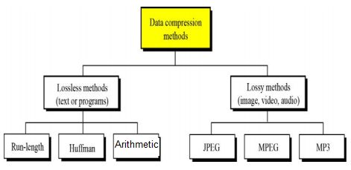

Slide 6
Classification of Compression Techniques
Entropy encoding
Lossless coding, decompression process regenerates the data completely
Used regardless of the media´s specific characteristics
Examples: Run-length encoding, Huffman encoding, Arithmetic encoding
Source encoding
Lossy coding
Semantics of the data are considered
Degree of compression depends on the data contents
Examples: (Differential) Pulse Code Modulation (DPCM) as content prediction technique, Discrete Cosine Transformation (DCT) as transformation technique
Hybrid encoding
Used by most multimedia systems
Combination of entropy and source encoding
Examples: JPEG, MPEG, H.261, DVI

Slide 7
Advantages of Compression
Reduce disk space required.
Seek distance and Seek times are reduced.
More data fits into each disk page, track and cylinder allowing more intelligent clustering of related objects into physically near locations.
Unused disk space can be used for shadowing to increase reliability.
Compressed data can be transferred faster to and from disk.
Data compression increases disk bandwidth.
Due to the information density there is a decrease in the load there for less I/O bottleneck.
Faster transfer rates across the network.
The log recorders can become shorter.

Slide 8
Drawback of data compression
Due to compression, some of the data is lost.
Compression and decompression increases complexity of the transmitter and receiver.
Coding time is increase due to compression and decompression.

Slide 9
Assignment
Compare lossless and lossy data compression.

Slide 10
5.2 Coding Fundamental
1. Coding Requirements / Storage and Bandwidth Requirements
Uncompressed audio signal of telephone quality:
sampled at 8 kHz, quantized with 8 bits per sample 64 kbits to store one second of playback
Uncompressed stereo audio signal of CD quality:
sampled at 44.1 kHz, quantized with 16 bits per sample →705.6 kbits to store one second of playback
PAL(Phase Alternating Line) video format:
25 frames/second →175.78 Mbits to store one second of video

Slide 11
Coding Requirements / Dialogue and Retrieval Mode
Supporting scalable video in different systems
format independent of frame size and video frame rate
Support of various audio and video data rates
data rates can be adjusted
Synchronization of audio and video data
Compatibility
Exchange multimedia data using communication networks
Programs available on CD can be read on different systems

Slide 12
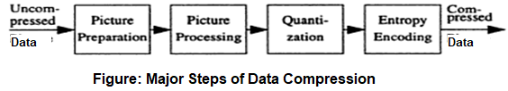
Data Compression Process
i. Picture preparation
analog-to-digital conversion
generation of appropriate digital representation
image division into 8X8 blocks
fix the number of bits per pixel
ii. Picture processing (compression algorithm)
transformation from time to frequency domain, e.g. DCT
It make use of sophisticated algorithm for compression.
iii. Quantization
Mapping real numbers to integers (reduction in precision).
E.g. U-law encoding - 12bits for real values, 8 bits for integer values
iv. Entropy coding
Compress a sequential digital stream without loss.
Adaptive Differential PCM (ADPCM) can be used.

Slide 13
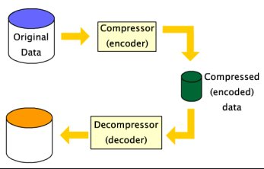
Decompression
It is the reverse process of data compression.
Decompression is the process of restoring compressed data to its original form.

Slide 14
Basic data compression technique
Run-length encoding
Huffman coding
Arithmetic coding
Other:
Pattern substitution
Diatomic encoding
Statistical coding, etc.

Slide 15
Run-length Encoding
A very simple form of lossless data compression in which runs of data (sequences in which the same data value occurs in many consecutive data elements) are stored as a single data value.
The general idea behind this method is to replace consecutive repeating occurrences of a symbol by one occurrence of the symbol followed by the number of occurrences.
It can be used in JPEG compression also.
Useful in: simple graphic images such as icons, line drawings , etc.
For example1:
Original Sequence:
11112223333331111AAA
can be encoded as: (compressed data)
(1,4),(2,3),(3,6),(1,4),(A,3)
OR, 1!4 2!3 3!6 1!4 A!3
Here, != refers to the repetition

Slide 16
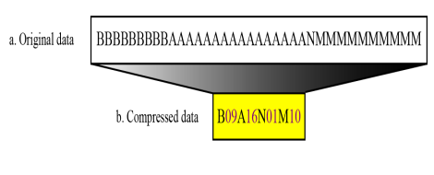
Example: 2

Slide 17
Huffman Coding
Huffman coding is based on the frequency of occurrence of a data item (pixel in images).
The principle is to use a lower number of bits to encode the data that occurs more frequently.
Commonly used method of lossless data compression.
The process of finding or using such a code proceeds by means of Huffman coding, an algorithm developed by David A. Huffman .
A Method for the Construction of Minimum-Redundancy Codes.
The output from Huffman's algorithm can be viewed as a variable-length code table for encoding a source symbol .

Slide 18
Huffman Coding Algorithm
Steps in Huffman coding example:
1. Make a leaf node for each code symbol.
2. Take any two leaf nodes with smallest probability and connect them into a new node.
Add 0 or 1 to each of two branches
The probability of new node is the sum of probability of the two connecting nodes.
3. If there is only one left, the code construction is completed. Otherwise, go back to step 2.

Slide 19
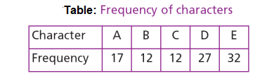
Example
Q. Encode and decode given characters using Huffman coding.
Note: Frequency can be given as probability.

Slide 20
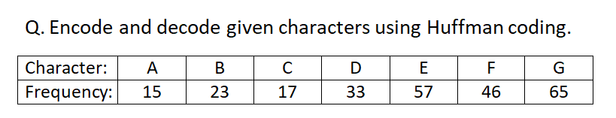
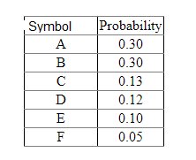
Assignment
Q. Encode and decode using Huffman coding.
In probability, sum must be always 1.

Slide 21
Arithmetic Coding
A form of entropy encoding used in lossless data compression.
It assigns shorter codes to symbols that occur more frequently and longer codes to those that occur less frequently.
It is differs from other forms of entropy encoding, such as Huffman coding, in that rather than separating the input into component symbols and replacing each with a code.
It encodes the entire message into a single number, an arbitrary-precision fraction q where 0.0 ≤ q < 1.0.

Slide 22
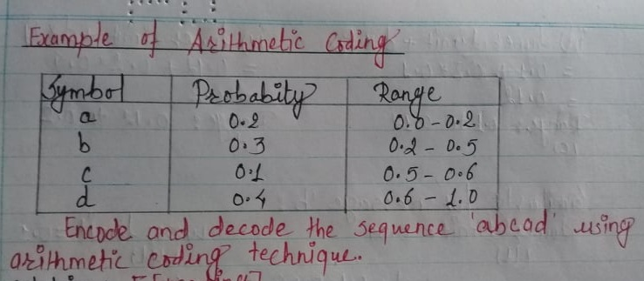
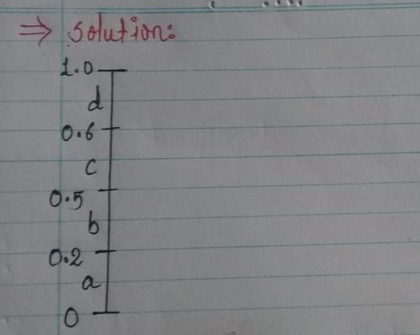

Slide 23
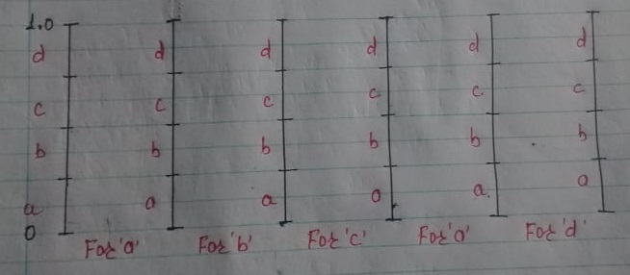

Slide 24
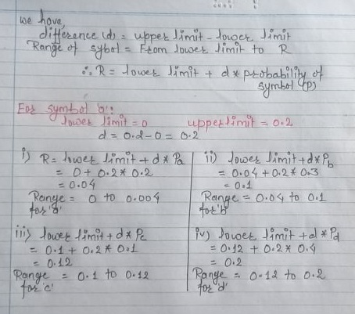

Slide 25
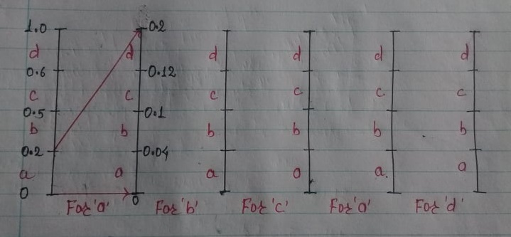

Slide 26
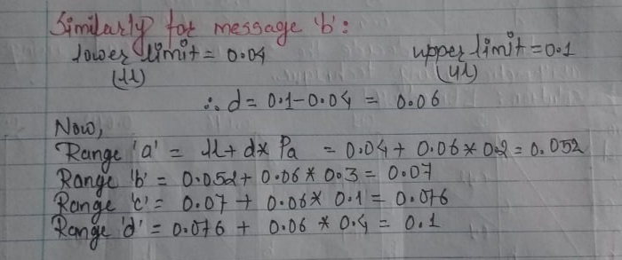
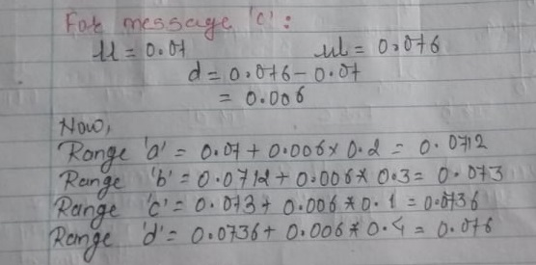

Slide 27
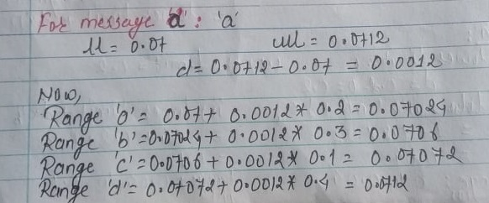

Slide 28
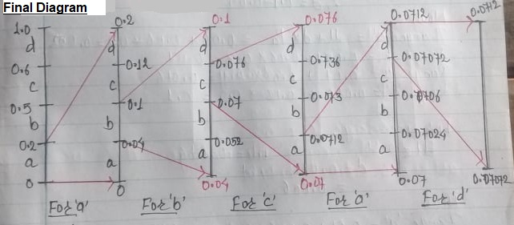

Slide 29
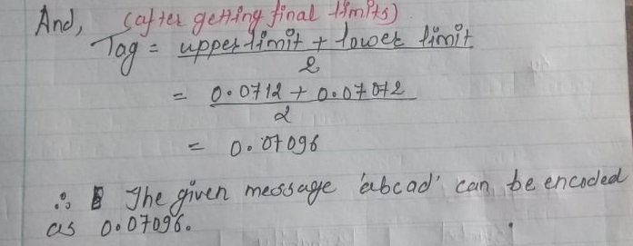

Slide 30
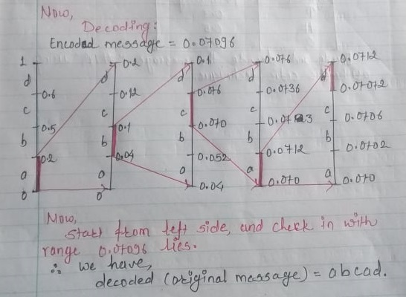

Slide 31
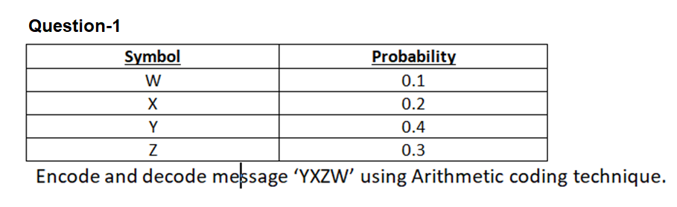
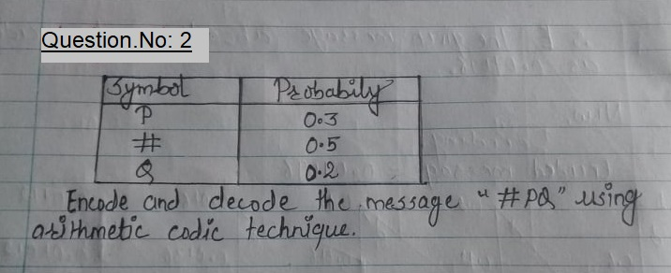
Assignments

Slide 32
5.3 Coding Standard: JPEG,MPEG and DVI
Coding Standard of JPEG
Joint Photographic Experts Group is the joint committee between ISO/IEC JTC 1 and ITU-T ) that created and maintains the JPEG, JPEG 2000, and JPEG XR standards.
Requirement of JPEG:
Design should address image quality
Should be applicable to any continuous tone digital source image.
Scalable & provide sequential encoding
Provide progressive encoding
Provide hierarchical encoding
Notes:
joint technical committee (JTC) of the International Organization for Standardization (ISO) and the International Electrotechnical Commission (IEC).
JPEG XR (JPEG extended range)

Slide 33
JPEG Modes
JPEG defines four modes, which themselves include additional variations:
The lossy, sequential DCT-based mode (baseline process, base mode) must be supported by every JPEG decoder.
The expanded lossy, DCT-based mode provides a set of further enhancements to the base mode.
The lossless mode has a low compression ratio and allows a perfect reconstruction of the original image.
The hierarchical mode accommodates images of different resolutions by using algorithms defined for the other three modes.

Slide 34
JPEG components:
Baseline sequential code
DCT progressive mode
Predictive lossless encoding
Hierarchical mode
Quantization /Dequantization
Entropy encoder/decode

Slide 35
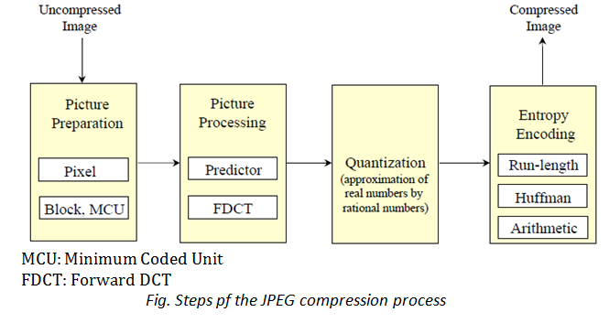
JPEG-Compression Steps

Slide 36
MCU (Minimum Coded Unit):
Series of images to be compress.
Usually these are of 8*8 pixels in size.
DCT (Discrete Cosine Transformation):
It expresses a finite sequence of data points in terms of a sum of cosine functions oscillating at different frequencies.
Applications in science and engineering, from lossy compression of audio (e.g. MP3) and images (e.g. JPEG).
FDCT (Fast Discrete Cosine Transformation):
Predictive coding model
In this model, it predicts the sample values from estimated and neighboring samples that are already coded in the image.

Slide 37
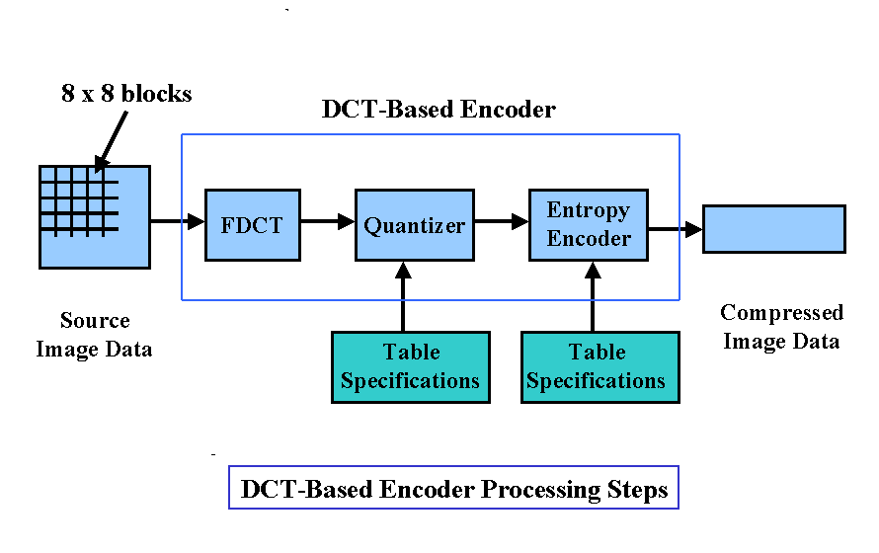
Fig: Steps of lossy sequential DCT-based coding model

Slide 38
JPEG - Variants / Progressive Encoding
Two alternatives:
Spectral selection:
First run: Only the low frequencies are given to the entropy encoder
Successive runs: Higher frequencies are used
Successive approximation
All quantized coefficients are processed but most significant bits are encoded first.

Slide 39
2. Coding Standard of MPEG
Moving Picture Experts Group.
It is an organization that develops standards for encoding digital audio and video.
It works with the International Organization for Standardization (ISO) and the International Electro-technical Commission (IEC) to ensure media compression standards are widely adopted and universally available.
It is suitable for both symmetric and asymmetric compression.
Asymmetric Compression:
It requires more effort for coding/ compression than for decoding.
Compression is carried out once, where as decompression is performed many time.
Symmetric Compression:
Expect equal effort for compression and decompression.

Slide 40
MPEG organization has produced a number of digital media standards since its inception in 1998
Some of examples are:
MPEG-1 – Audio/video standards designed for digital storage media (such as an MP3 file)
MPEG-2 – Standards for digital television and DVD video
MPEG-4 – Multimedia standards for the computers, mobile devices, and the web
MPEG-7 – Standards for the description and search of multimedia content
MPEG-MAR – A mixed reality and augmented reality reference model
MPEG-DASH – Standards that provide solutions for streaming multimedia data over HTTP.

Slide 41
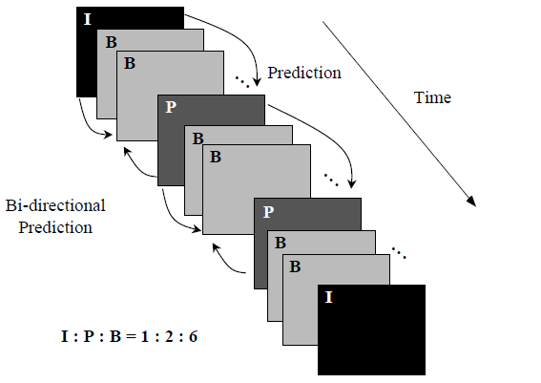
4 different types of image coding in MPEG:
I-frames (Intra-coded images
P-frames (Predictive-coded frames)
B-frames (Bi-directionally predictive-coded frames)
D-frames (DC-coded frames)

Slide 42
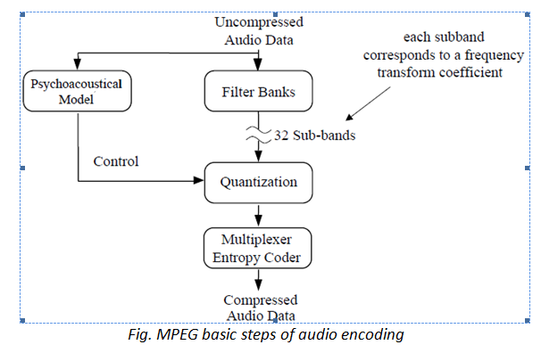
Audio Encoding using MPEG
Psychoacoustics is the branch of science that studies sound perception. It studies sound and its effects on compression.

Slide 43
DVI coding standard
Digital Video Interactive (DVI)
First multimedia desktop video standard for IBM-compatible personal computers.
It enabled full-screen, full motion video, as well as stereo audio, still images, and graphics to be presented on a DOS-based desktop computer.
It can process(compress and decompress) data, text, graphics, audio and video, etc.
It is video connection standard created by Digital Display Working Group (DDWG).

Slide 44
Types:
DVI-A (For analog data)
DVI-D (For digital data)
DVI-I (Integrated for both analog and digital data)
Fundamental components of DVI (Digital Video Interface):
VLSI(Very-large-scale integration) chip for video subsystem
well-specified data format for audio and video files
application user interface to audio-visual kernel (AVK)
compression and decompression algorithms *Presentation-Level Video (PLV)
It is suitable for applications distributed on CD-ROMs.
Real-Time Video (RTV)

Slide 45
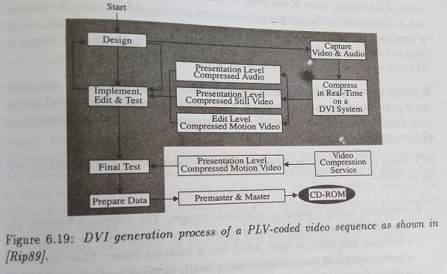

Slide 46
Here,
VDP: Video display processor
VDP1: Processes bit maps
VDP2: Generates analog RGB signals
VRAM: Video RAM
D/A: Digital-to- analog
IF: Information fetch
Video RAM:
It is dual ported variant of dynamic RAM.
It can be accessed by 2- different devices simultaneously.

Slide 47
End of Chapter-5.
Assignment:
Lossy Vs Lossless data compression method
Entropy encoding vs Source coding

